Slide 1

Revolutionizing access to the financial markets for the average American

Slide 2
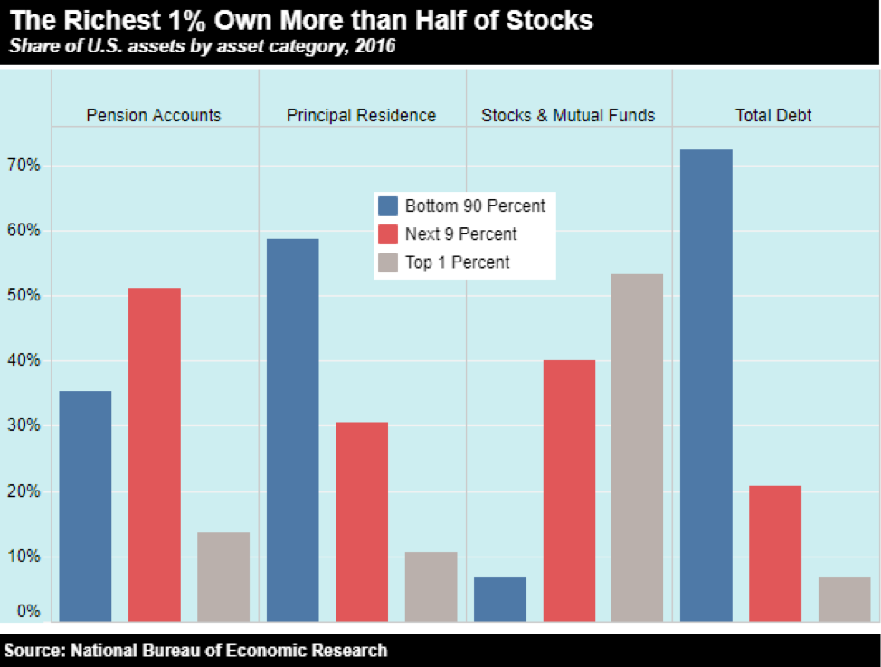
Top 10% Own More Than 93% of Stocks & Mutual Funds

Slide 3
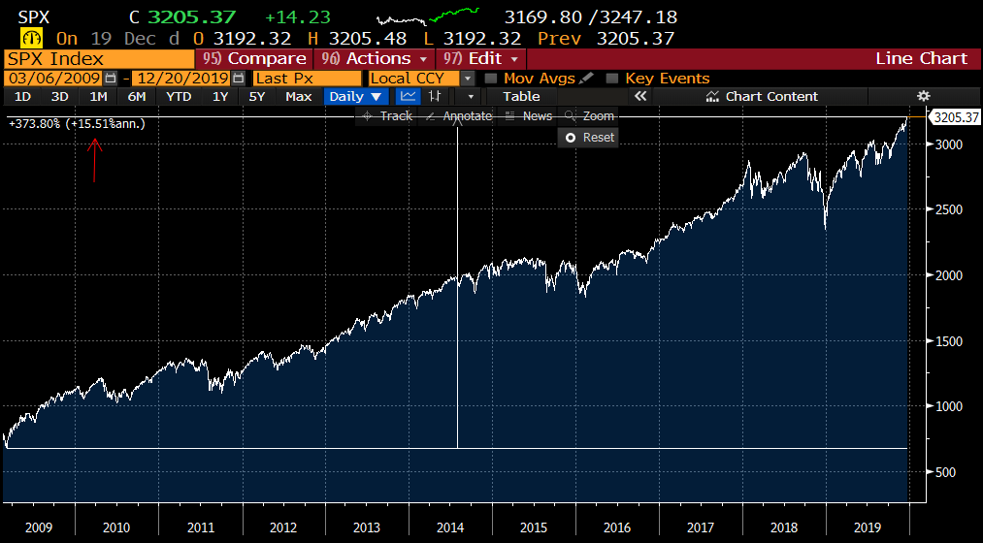
Most missed out on largest bull run!

Slide 4

Turning Consumers Into Investors

Slide 5
Stash Results
$1.88 Billion have been “Stashed Away”
4 Million Users & Growing
86% of Stashers are First Time Investors
$5 Million in Stock Back Rewards Earned

